Slide 1
College Admission Agent
IBM HACKATHON PROJECT
Presented By:
Student name : PRIYANKA PRIYADARSHANI PRADHAN
College Name : ITER Siksha 'O' Anusandhan (SOA) University
Department: B.TECH COMPUTER SCIENCE AND ENGINEERING (DATA SCIENCE)

Slide 2
OUTLINE
Problem Statement
Technology used
Wow factor
End users
Result
Conclusion
Git-hub Link
Future scope
IBM Certifications

Slide 3
Problem Statement
The Challenge: Prospective students often struggle to find clear, accurate, and up-to-date information about college admissions. Important details on eligibility, courses, fees, deadlines, and application processes are spread across websites, PDFs, and FAQs, making it hard to access quickly.
Proposed Solution: A College Admission Agent powered by Retrieval-Augmented Generation (RAG) that answers student questions in natural language by retrieving real-time data from official sources. It provides instant, accurate guidance on course selection, requirements, fees, and deadlines—improving accessibility, reducing manual inquiries, and enhancing the admission experience.
Built on IBM Cloud Lite and using IBM Granite models, this AI agent ensures reliable, transparent, and scalable support for students and institutions.

Slide 4
Technology used
IBM cloud lite services
Natural Language Processing (NLP)
Retrieval Augmented Generation (RAG)
IBM Granite model

Slide 5
IBM cloud services used
IBM Cloud Watsonx AI Studio
IBM Cloud Watsonx AI runtime
IBM Cloud Agent Lab
IBM Granite foundation model
IBM Cloud Object Storage
IBM IAM (Identity and Access Management)

Slide 6
Wow factors
This agent will significantly reduce admission-related confusion, improve the quality of student decision-making, assist applicants with accurate and real-time college information, and enhance transparency in the admission process by making institutional policies more accessible and actionable.
Unique features:
Interactive chatbot for admission guidance
Accurate responses using uploaded policy documents
No-code development via Watsonx Agent Lab
Runs completely on IBM Cloud Lite (free tier)
Scalable, customizable, and cost-efficient for colleges

Slide 7
End users
B.Tech aspirants
Diploma holders
Parents and guardians
College admission staff
Educational institutions

Slide 8
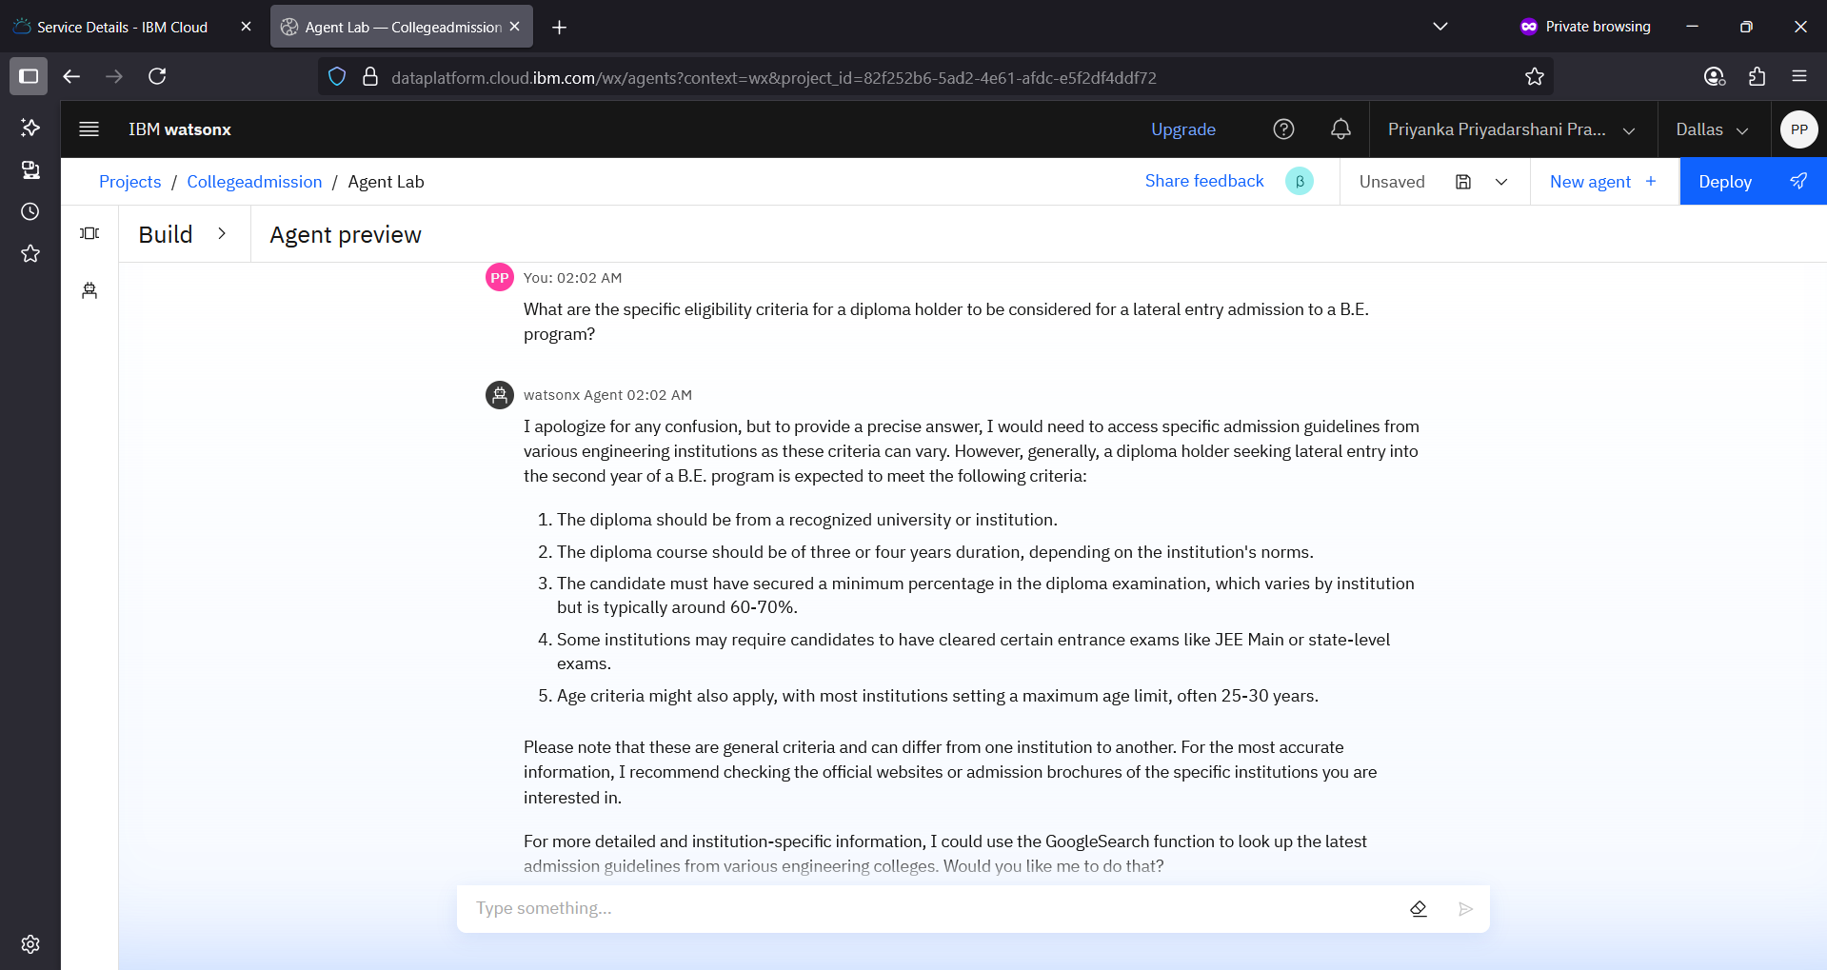
Results

Slide 9
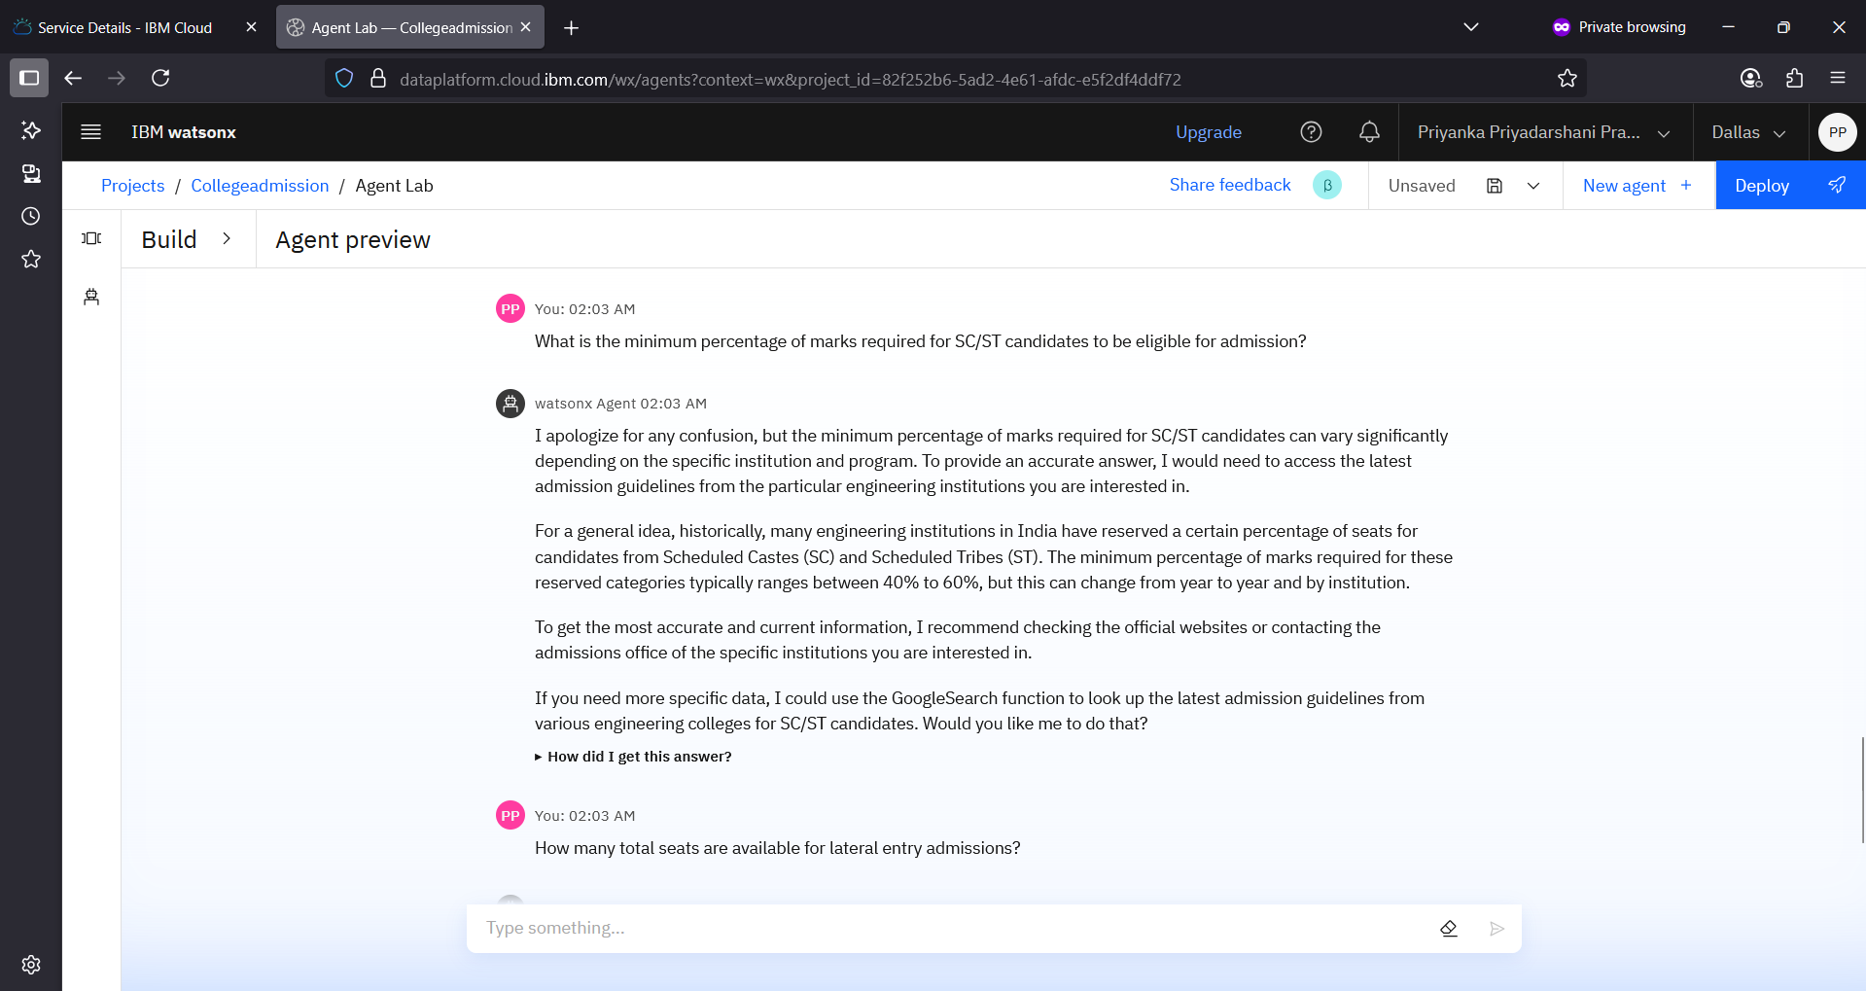
Results

Slide 10
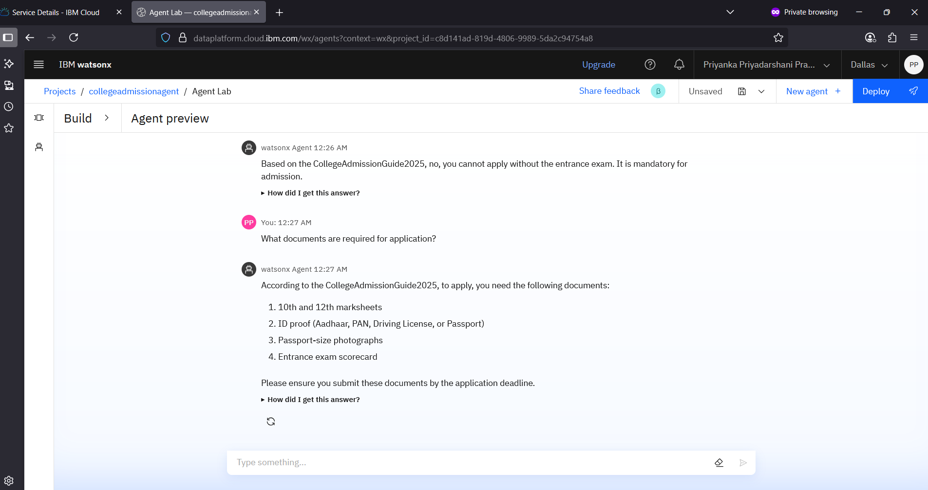
Results

Slide 11
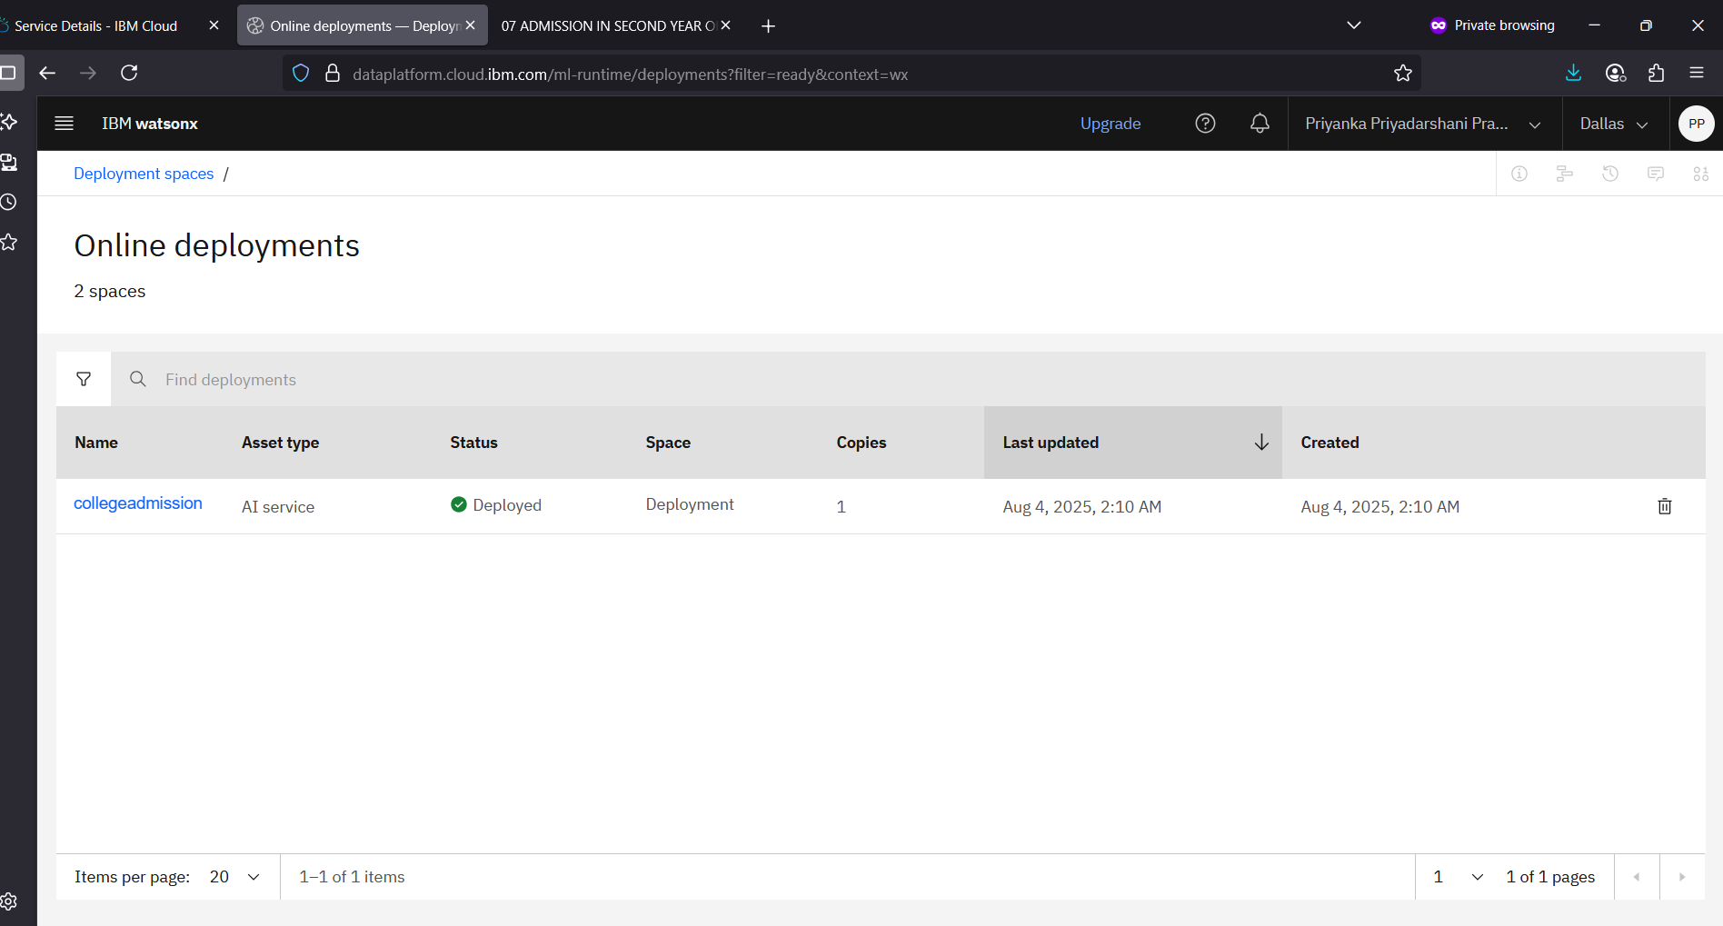
Results
Deployed AI Agent

Slide 12
Conclusion
The College Admission Agent simplifies the admission process by providing instant, accurate answers using AI and institutional documents.
Built with IBM Cloud Lite and Granite LLM, it offers a no-cost, no-code solution ideal for educational use.
Its scalable, document-based design makes it adaptable for multiple colleges and programs.
The project demonstrates how AI can enhance accessibility, reduce manual work, and improve the student experience in admissions.
Saves time by automating repetitive tasks like citation management and data extraction.

Slide 13
Future scope
Multilingual Admission Support
Voice-Activated Query Handling
Real-Time Updates from University Portals
Personalized Course and College Recommendations
Integration with Application Submission Platforms
AI-Based Eligibility and Document Validation

Slide 14
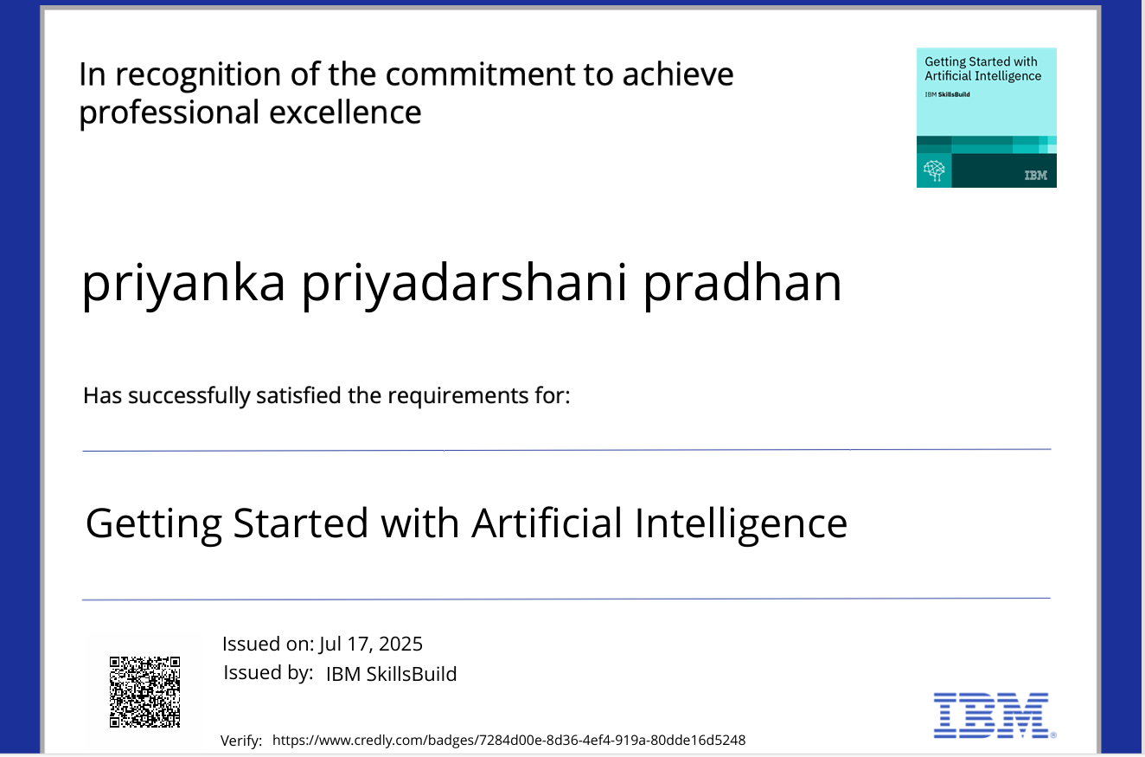
IBM Certifications

Slide 15
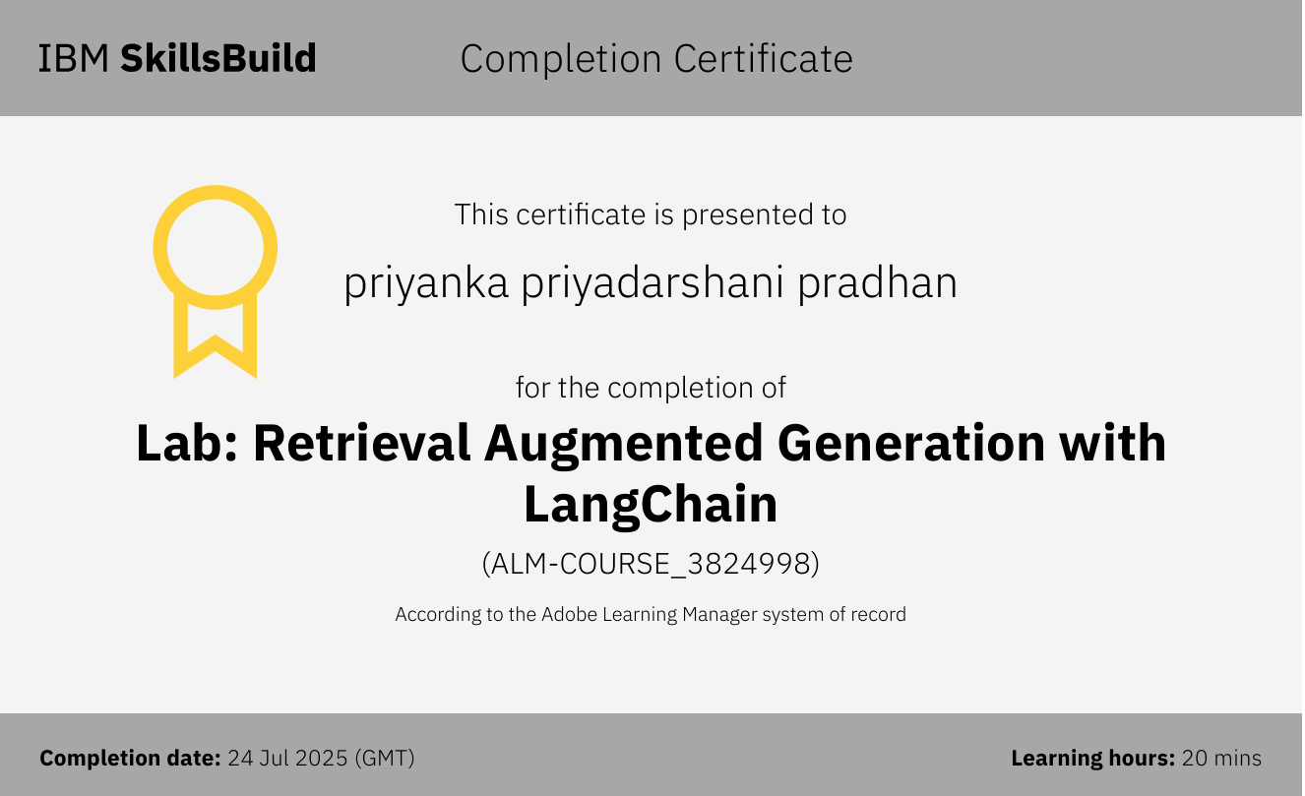

Slide 16
THANK YOU

